Slide 1
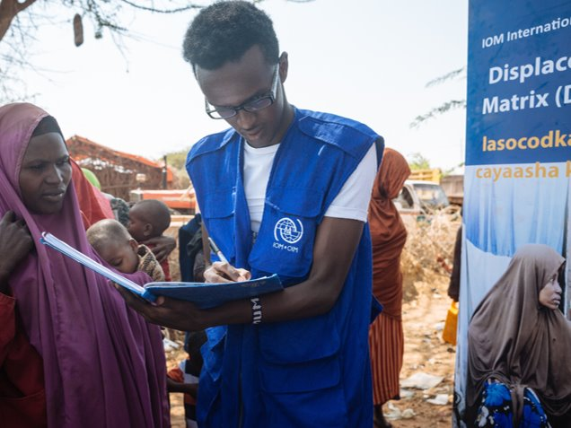
GENDER-BASED VIOLENCE RISKS
AND DTM:
WHAT SHOULD DTM ENUMERATORS KNOW?
Turkey/Antalya
Oct 17-18, 2018
Notes:
Background: GBViE, Call to Action, IOM supported since 2014 to mainstream GBV in several sectors of assistance, including CCCM, shelter and DTM. Objective: Doing better a protection women and girls in emergencies. Global cooperation with the GBV AoR.

Slide 2
Part 1
GENDER BASED VIOLENCE AND DTM

Slide 3
Learning objectives
Be able to differentiate between Sex and Gender
Define GBV
Identify forms of GBV, root causes, contributing factors and consequences of GBV
Understand how emergencies can exacerbate GBV risks
GENDER BASED VIOLENCE AND DTM

Slide 4
Sex vs. Gender
Sex | Gender
Physical/ biological differences between females and males
Social differences between males and females
Does not change (without surgical intervention)
Determined by social factors – history, culture, tradition, societal norms, religion
Can change over time
What are the gender traits of women and men in your culture, and how does this differ from other cultures?
GENDER BASED VIOLENCE AND DTM

Slide 5
GBV – true or false?-
GBV is about rape and sexual violence
GBV can be perpetrated against boys and men too
Culture needs to be always respected even if it is harmful for girls and women.
Domestic violence is the result of poverty and lack of education.
If a young woman wear an inappropriate dress that provoke men sexually, it’s her fault to be raped.
Consequences of GBV are always same for all survivors.
GENDER BASED VIOLENCE AND DTM
Notes:
Please change the statement as needed.
GBV is about rape and sexual violence (False): Answer: There are different types of GBV and we will look at different types.
GBV can be perpetrated against boys and men too (true): Answer: GBV can be perpetrated against boys and men. But vast majority of survivors are women and girls due to gender-inequality and power imbalance between male and female.
Culture needs to be always respected even if it is harmful for girls and women (false): Answer: Harmful traditional practice such as child marriage causes negative impact to the survivor, family and community. These harmful traditional practices need to be addressed even if it is a part of the culture of the society.
GBV includes domestic violence(true): Answer: Most common forms of violence is domestic violence perpetrated by an intimate partner.
Domestic violence is the result of poverty and lack of education (false): Answer: not all family who are poor and have little education background commit domestic violence. Domestic violence happens because of the gender inequality and power imbalance between male and female.
If a young woman wear an inappropriate dress that provoke men sexually, it’s her fault to be raped (false): It is ALWAYS fault of perpetrators and never survivor’s fault under any circumstances. It is very common to blame survivors. It is important to emphasize that survivor has not fault. Alternative question could be “It is always husband’s fault if he beats her wife”. (true)
Consequences of GBV are always same for all survivors. (false) Answer: the consequences of GBV is different depending of the type of violence perpetrated, the age, capacity and protection mechanism of the survivor. The individual support a survivors needs could also be different. Is the survivor is an adult they know the best what services they will need once they know all the available services.

Slide 6
Gender-Based Violence (GBV)
Gender-based Violence (GBV) is an umbrella term for any harmful act that is perpetrated against a person’s will and that is based on socially ascribed (i.e. gender) differences between males and females.
It includes acts that inflict physical, sexual or mental harm or suffering, threats of such acts, coercion, and other deprivations of liberty. These acts can occur in public or in private.
GENDER BASED VIOLENCE AND DTM
Notes:
Further información: ALNAP Protección Guide

Slide 7
Types of GBV
Physical Assault
Trafficking, Slavery
Infanticide
Honor Killing and Maiming
Abuse, Humiliation
Confinement/Isolation
Intimidation/Threats
Social Exclusion, ostracism based on sexual orientation
PHYSICAL
EMOTIONAL
ECONOMIC
SEXUAL
Discrimination, and/or denial of opportunities
Forced Marriage/Early Marriage
Denial of Education for Women and Children
Forced Marriage
Sexual Exploitation/Forced Prostitution
Survival Sex
Rape and Marital Rape
Child Sexual Abuse, Defilement, Incest
Notes:
Use this as a part of wrap up of the GBV tree.
Adjust the type of GBV – according to the types of GBV common in the CXB’s context.

Slide 8
Understanding GBV- Exercise
In groups of 5 people, identify:
Root causes for gender based violence and risk factors that may increase the likelihood of GBV in your context?
Consequences of different forms of GBV?
- Physical, social, economic, psychological?
GENDER BASED VIOLENCE AND DTM

Slide 9
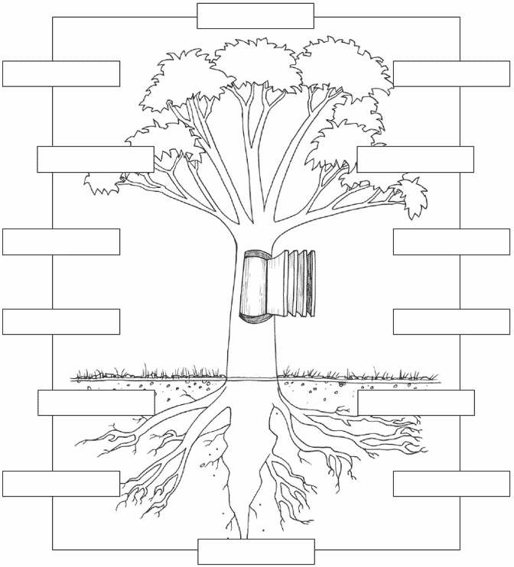
Consequences of GBV
Forms of GBV
Root causes and contributing factors
GENDER BASED VIOLENCE AND DTM

Slide 10
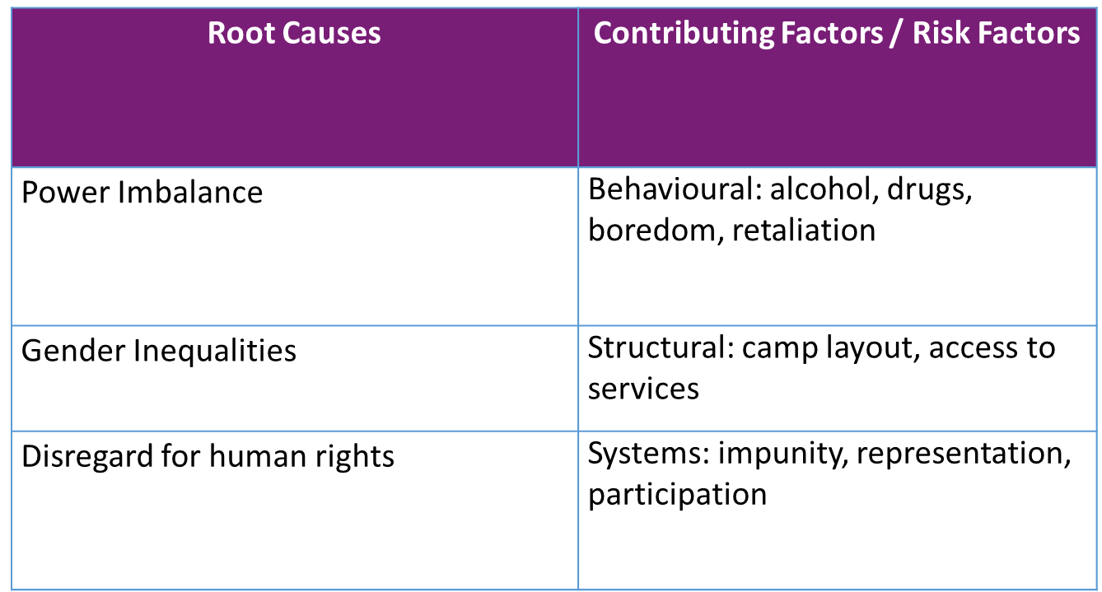
Root causes and contributing factors of GBV
GENDER BASED VIOLENCE AND DTM
Notes:
POWER
Power is the ability to control and access resources, opportunities, privileges and decision-making processes
The power is not bad thing and can be used to protect vulnerable person but when the person with power abuse his/her power, violence can occur
Power dynamics in the community creates barriers to seek support, access to services etc.
Important to note that behavioral are not about the survivors behavior (to negate victim blaming). This are about the perpetrators behavior.

Slide 11
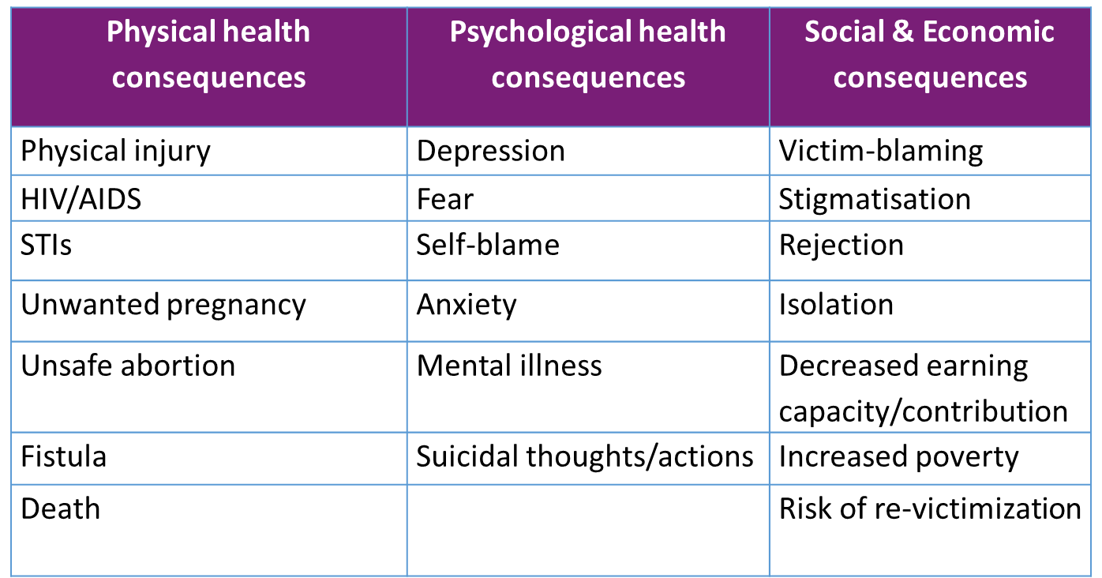
Consequences of GBV
GENDER BASED VIOLENCE AND DTM

Slide 12
Why does GBV occur in emergencies?
Pre-existing - exists independent of, or prior to emergency or conflict
Emergency-related - specific to/resulting from the disaster or conflict
Humanitarian-related - caused directly or indirectly by humanitarian environment
GENDER BASED VIOLENCE AND DTM

Slide 13
How is GBV exacerbated in emergencies?
New threats/forms of GBV related to conflict
Lack of privacy; overcrowding; lack of safe access to basic needs
Design of humanitarian aid heightens or introduces new GBV risks
Separation from family members; lack of documentation; registration discrimination
Breakdown of protective social mechanisms and norms regulating behaviour
Increased vulnerability and dependence; exploitation
Introduction of new power dynamics, as with humanitarian actors
GENDER BASED VIOLENCE AND DTM

Slide 14
Summary of GBV – Part 1
GBV is rooted in gender and power inequalities that exist outside of conflict or disaster but that can be exacerbated by it.
Always assume that GBV is occurring.
Obtaining data about incidents cannot be used as “evidence”, and is NOT advisable and NOT our role in an emergency.
GENDER BASED VIOLENCE AND DTM

Slide 15
Part 2
GENDER BASED VIOLENCE AND DTM

Slide 16
Learning objectives
Understand the role of non-GBV specialists in GBV prevention, mitigation and response
Know how to safely and ethically respond to a GBV and child protection incident disclosure
GENDER BASED VIOLENCE AND DTM

Slide 17
Roles and responsibilities towards GBV
SPECIALIZED PROGRAMMING: specialists
Direct service delivery
Case management
GBV specialized psychosocial support
Clinical care
Legal support
Economic reintegration
GBV “MAINSTREAMING” all actors
Avoid creating or exacerbating risks of GBV
Reduce existing risks
Understand and link to specialist services for GBV survivors
Applying core minimum standards into agency activities
How to mainstream GBV in the DTM?
GENDER BASED VIOLENCE AND DTM

Slide 18
What a DTM enumerator should do to mainstream GBV
Avoid creating or exacerbating risks of GBV.
Inform yourself about services available for GBV survivors
GENDER BASED VIOLENCE AND DTM

Slide 19
Avoid creating or exacerbating risks of GBV
IOM Standards of Conduct
Prevention of Sexual Exploitation and Abuse (PSEA) by aid workers
Do no harm
GENDER BASED VIOLENCE AND DTM

