Slide 1
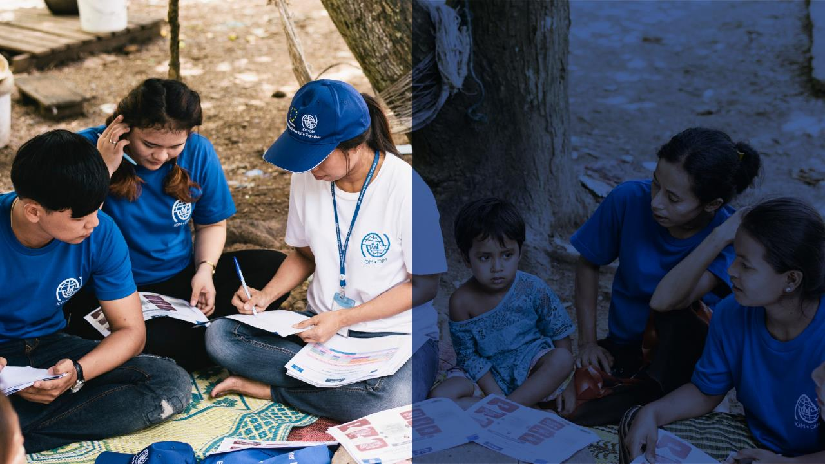
INTRODUCTION TO COUNTER-TRAFFICKING IN EMERGENCIES INFORMATION MANAGEMENT
SESSION 4
COUNTER-TRAFFICKING IN EMERGENCIES:
RESEARCH METHODS
International Organization for Migration
Benedetta Cordaro

Slide 2
THIS WEBINAR WILL BE RECORDED
INTRODUCTION TO COUNTER-TRAFFICKING IN EMERGENCIES INFORMATION MANAGEMENT
SESSION 5
COUNTER-TRAFFICKING IN EMERGENCIES:
RESEARCH METHODS
PLEASE MUTE YOUR MICROPHONE
PLEASE TURN OFF YOUR CAMERA
FOR ANY QUESTION, PLEASE USE THE CHAT BOX

Slide 3

Author
Benedetta Cordaro
Counter-Trafficking in Emergencies
Migrant Protection and Assistance (MPA)

Slide 4
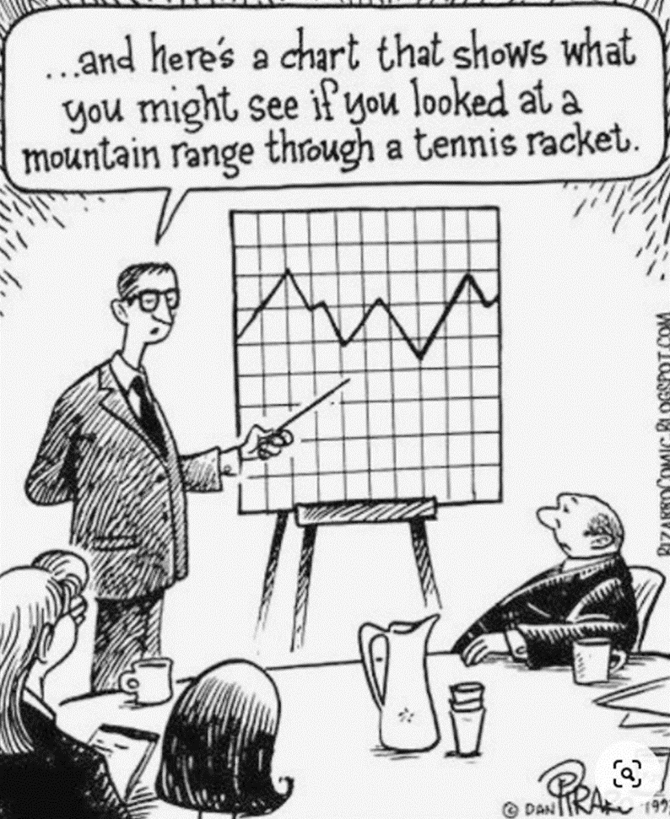
Agenda
Reminder: training curriculum
Research methods:
  Research strategy and methodology
  Sources and sampling strategies
  Research methods
  Exercise
Questions

Slide 5

OBJECTIVES
Understanding the different applications of qualitative and quantitative research methods
Understanding the phases of a research strategy and the components of a methodology
Familiarization with the main quantitative methods and application to CTiE IM
Familiarization with the main qualitative methods and application to CTiE IM

Slide 6
Reminder: Training curriculum
Module
Module 1 - Trafficking in persons in emergencies and role of CTiE IM
Module 2 - Ethical concerns and safeguards: protection information management
Module 3 - CT information management in emergencies: CTiE analysis framework
Module 4 - CTiE information management in emergencies: CTiE indicators
Module 5 - CT information management in emergencies: research methods

Slide 7

1. Research strategy and methodology

Slide 8
1. Research strategy and methodology
RESEARCH
STRATEGY
A research method is only one of the components of a research methodology
And a research methodology only constitutes one of the phases of the research strategy.
METHODOLOGY
METHOD

Slide 9
1. Research strategy and methodology
ANALYSIS FRAMEWORK TO IDENTIFY INFORMATION NEEDS AND GAPS
REASONS FOR SOURCE SELECTION
RESEARCH METHOD
RESEARCH QUESTION
LITERATURE AND SECONDARY DATA REVIEW
RISK AND CAPACITIES ASSESSMENT
METHODOLOGY
SAMPLING STRATEGY
ENUMERATORS / RESEARCHER
DEFINED
AND
WITH A CLEAR PURPOSE*
PIM N.3
TO USE SECONDARY DATA FIRST AND NOT REINVENT THE WHEEL
DO NO HARM
WHERE, WHEN AND HOW DATA ARE COLLECTED
LIMITATIONS
Notes:
*Poor research question: Why do people mistrust law-enforcement bodies?
(Bias: The researcher assumes there is mistrust. | “People” is too broad: Is the researcher interested in the entire country or only a province?)
Better research questions: What is the perception of law-enforcement bodies among populations in province X? What factors affect this perception? Is there a connection between perception and attitudes towards law-enforcement bodies and reporting cases of TIP?
PIM Principle 3 (Defined purpose) and the need to respond to these three questions:
What is this information going to be used for?
What information is needed to support that purpose?
When is this information needed so that it can be effectively used for said purpose?
Here they have letters, in chapter 3 they do not. Can we remove?

Slide 10
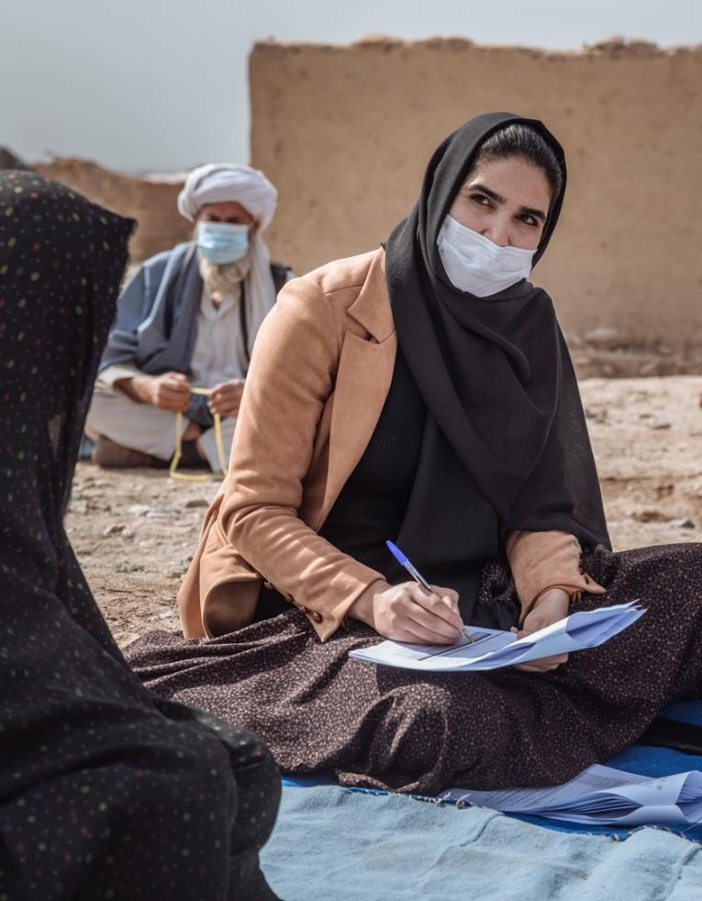
1. Research strategy and methodology
EXERCISE
What are the components of the methodology adopted in the example?
* PLEASE WRITE IN THE CHATBOX

Slide 11
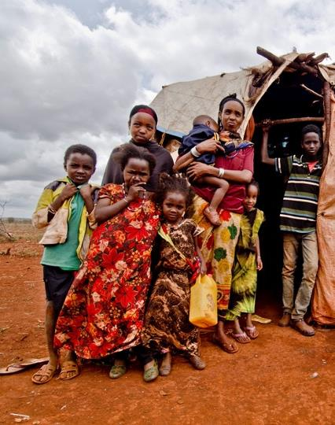
1. Research strategy and methodology
EXAMPLE 1:
A foreign NGO organizes focus group discussions, led by the NGO international staff, with the elders of the villages in the area where they work. They chose the elders as they are authority figures in the local society. The discussions are held in villages, rather than in the organization’s office. Local NGO staff translates.

Slide 12
1. Research strategy and methodology
EXAMPLE 2:
A foreign NGO engages in focus group discussions, with the support of a local partner. The local partner's team conducts interviews with different categories of people, women and adolescents, and not just the elderly. The interviews are organized by staff members who speak the local language and maintain a strong relationship of trust with the local population.

Slide 13
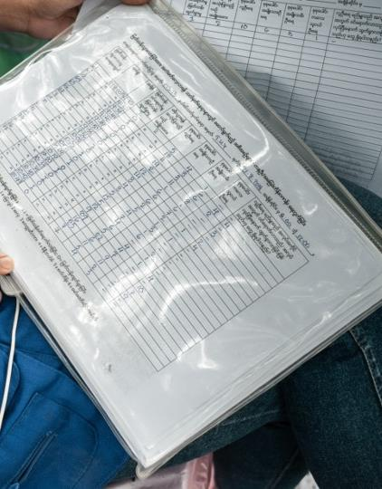
1. Research strategy and methodology
CAN WE TELL ONE OF THE TWO EXAMPLES IS BETTER?
Do we have all the information we need to judge the difference?

Slide 14
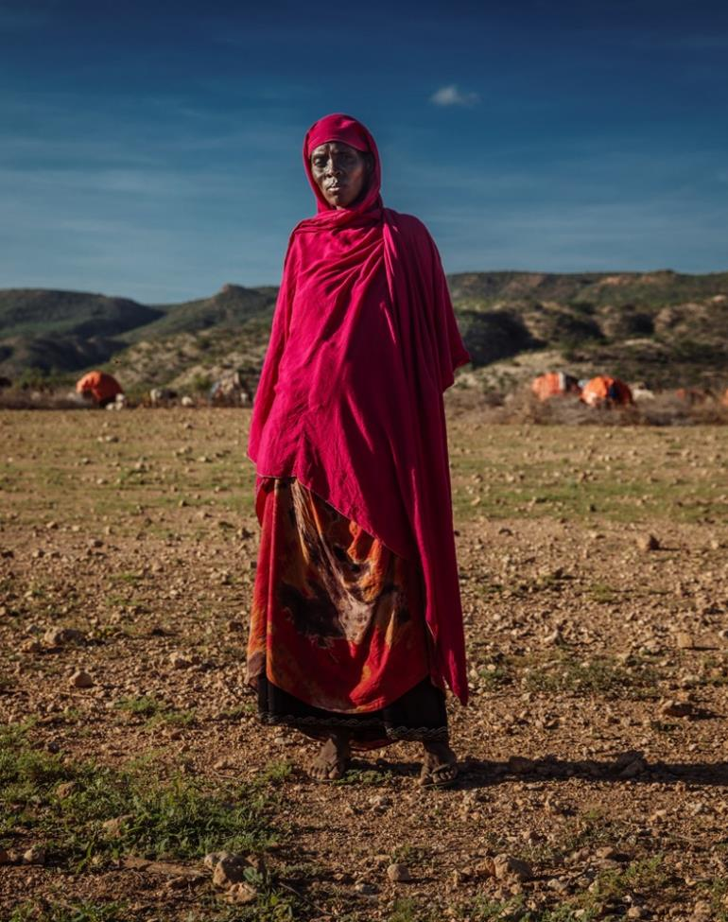
1. Research strategy and methodology
A METHODOLOGY DOCUMENT IS CRUCIAL:
Allows to evaluate the quality of the study
Explains why the data are credible
Explains how the results have been achieved (if someone wants to use the same methodology)
Explains the limitations
Allows you to share and compare data
A RESEARCH WITHOUT A METHODOLOGY IS JUST AN OPINION

Slide 15
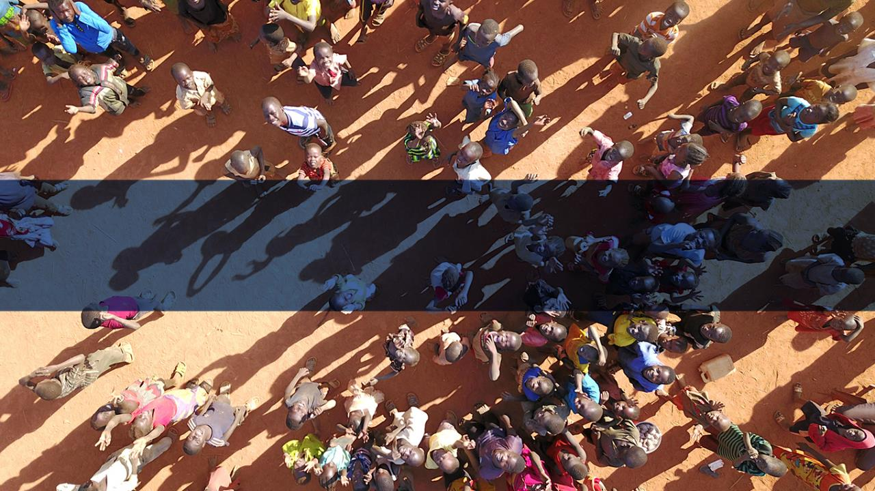
2. Sources and sampling strategies

Slide 16
2. Sources and sampling strategies
SOURCE
METHOD
FROM WHOM, WHAT, OR WHERE do I collect information?
Who should I ask?
HOW do I collect the information?
How do I ask?

Slide 17
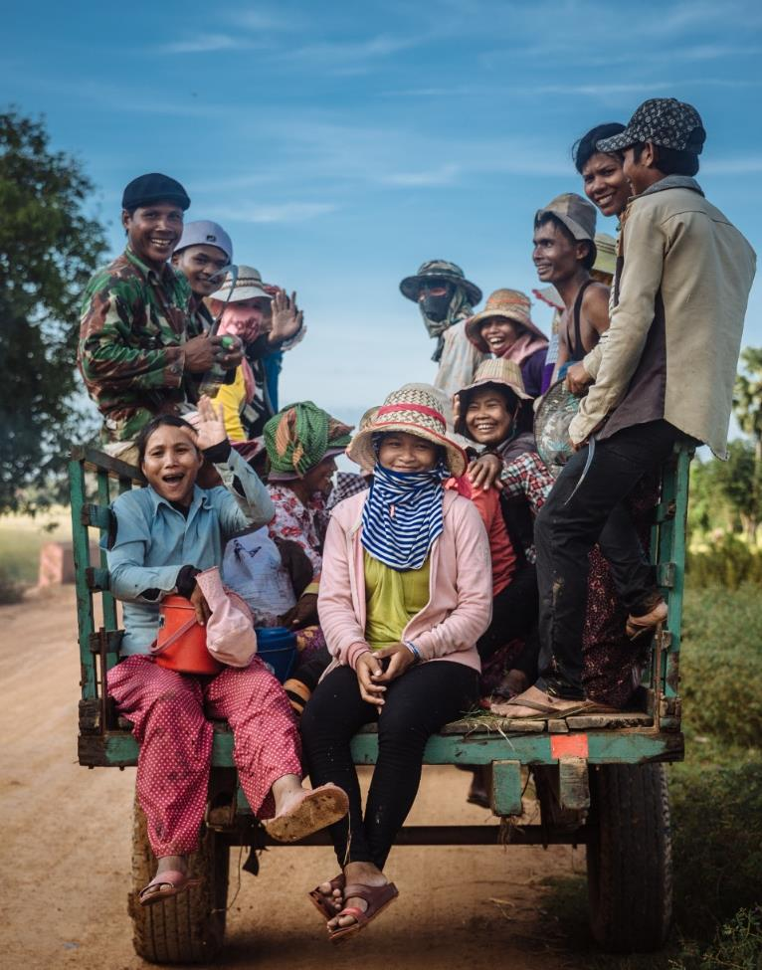
2. Sources and sampling strategies
EXAMPLE OF SOURCES
Persons
Written texts (newspapers, manifestos, political posters, advertisements, Facebook, letters, documents)
Images (photo and / or video)
Archive records
Artifact or works of art
Reality / environment (through direct observation)

Slide 18
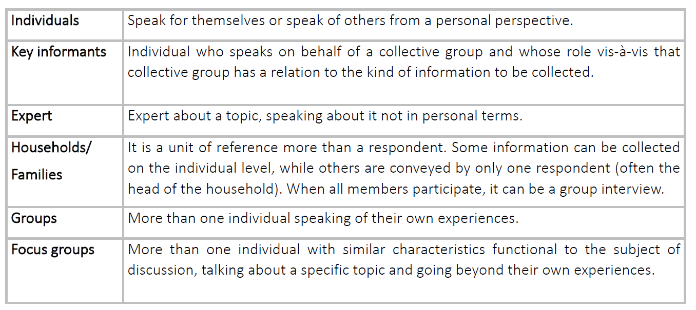
2. Sources and sampling strategies

Slide 19
2. Sources and sampling strategies
The process of selection of respondents
(or sources)
SAMPLING
STRATEGY
Please see document in Session 5 folder on sampling strategies and key simplified concepts to understand probabilistic sampling.
The document is meant to help reader with no background in statistics to understand other methodologies.

Slide 20
2. Sources and sampling strategies
RULE OF THUMB:
If you cannot do something (small scale) on paper, do not think a software will sort out your problem
Example:
if you do not understand the statistics and the formulas behind the calculation of a sample size, do not attempt by just using an online calculator.
If you cannot analyse qualitative data manually, do not think Nvivo is your solution.

Slide 21
2. Sources and sampling strategies
SAMPLING
PROBABILISTIC
NON PROBABILISTIC
In a simple randomized sample*, all participants (out of the reference population) have the same probability of being selected, and that probability is known.
If there is a population of 100, each person has 1 out of 100 probabilities to be selected.
Total is unknown or the sampling strategy does not allow all participants to have the same probability of being selected.
The sample is supposed to be, in a way, a micro-version of the population of interest.
The sample represent only itself
Findings are generalisable
Findings are not generalisable
… sampling is an art

Slide 22
5 minutes break

Slide 23
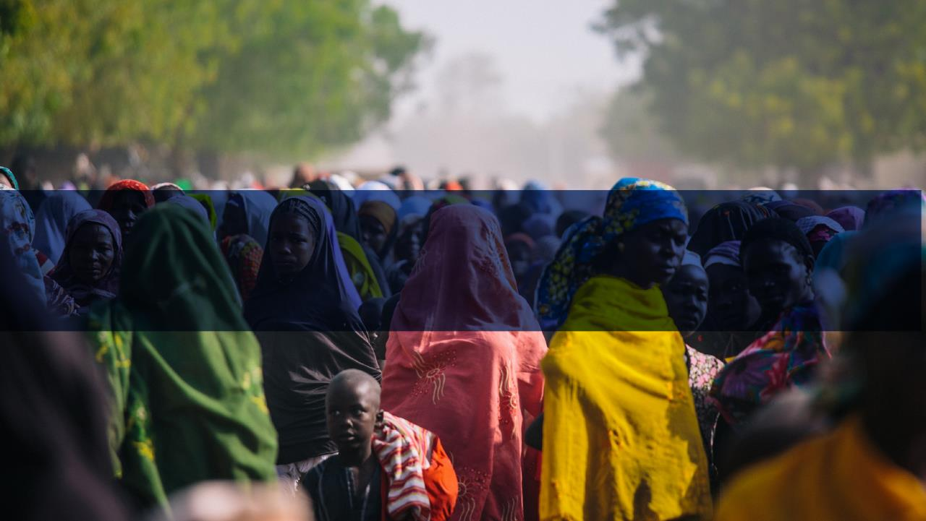
3. Research methods

Slide 24
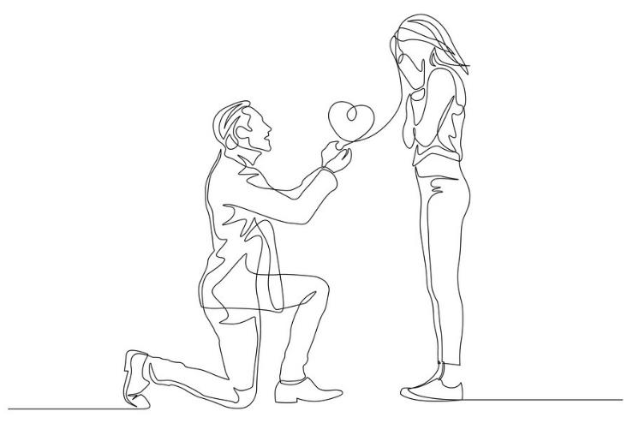
3. Research methods
Is a quantitative information always the best choice?
- I love you so much!
- Really? How much from one to ten?

Slide 25
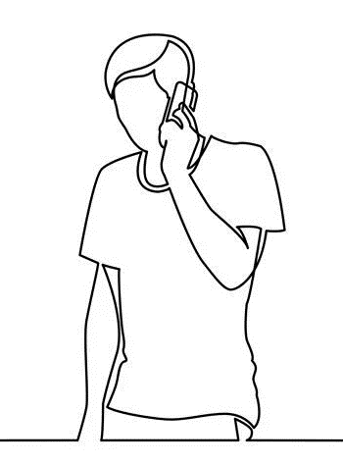
3. Research methods
Is a qualitative information information always the best choice?
Hi, I would like to book a table
Sure, for how many people?
Some
Ok, but how many exactly?
Enough
…. And when? At what time?
Time is a relative concept

Slide 26
3. Research methods
 | Qualitative | Quantitative
PROS
CONS
EXAMPLES

Slide 27
3. Research methods
 | Qualitative | Quantitative
PROS | Allow to go in depth and capture nuances and meanings Allow to follow up immediately during data collection if something is unclear Open-ended question (more options than anticipated by the researcher) | Allow to quantify and measure Allow to see correlations Allow to generalize (depending on method and sampling) Larger geographical coverage Larger sample
CONS | Small number of respondents Time-consuming Findings cannot be generalized | Cannot follow up immediately during data collection* Number of options is usually limited
EXAMPLES | Observation Social-media monitoring Personal narrative Individual interviews (e.g. face-to-face, on phone) In depth Semi-structured Group interviews Focus group discussions | Observation Surveys Administered by a researcher/enumerator Self-administered Online In person

Slide 28
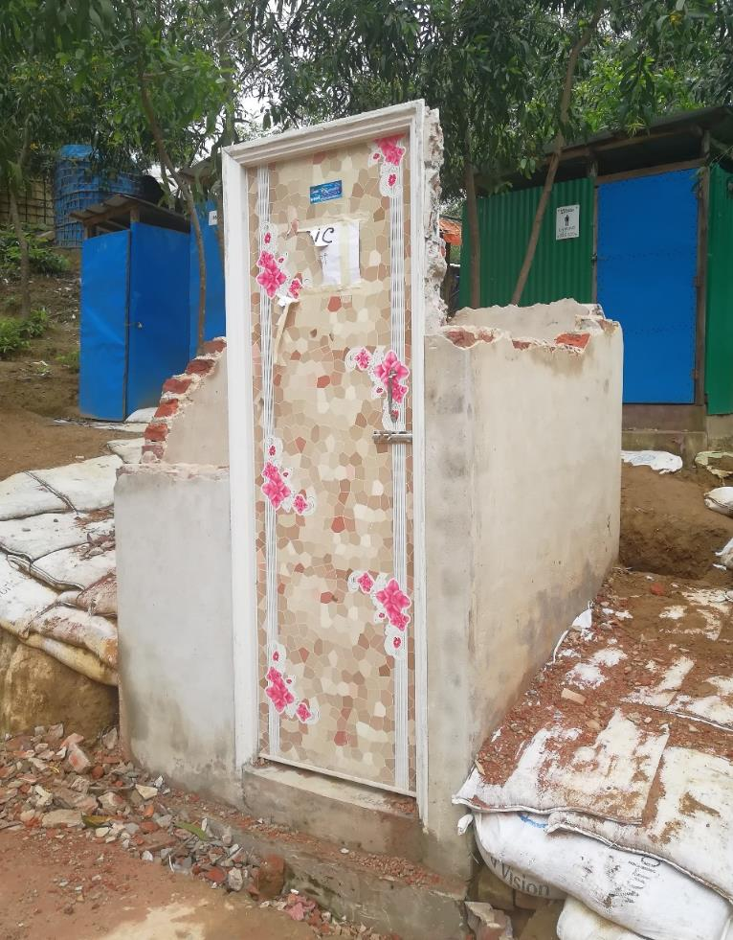
3. Research methods
Magnificent example of issue related to immediate follow up.
The questionnaire asked about the presence of light and functioning locks.
And the lock actually worked …

Slide 29
3. Research methods
 | Qualitative | Quantitative
PROS | Allow to go in depth and capture nuances and meanings Allow to follow up immediately during data collection if something is unclear Open-ended question (more options than anticipated by the researcher) | Allow to quantify and measure Allow to see correlations Allow to generalize (depending on method and sampling) Larger geographical coverage Larger sample
CONS | Small number of respondents Time-consuming Findings cannot be generalized | Cannot follow up immediately during data collection* Number of options is usually limited
EXAMPLES | Observation Social-media monitoring Personal narrative Individual interviews (e.g. face-to-face, on phone) In depth Semi-structured Group interviews Focus group discussions | Observation Surveys Administered by a researcher/enumerator Self-administered Online In person

Slide 30
3. Research methods
 | Qualitative | Quantitative
PROS | Allow to go in depth and capture nuances and meanings Allow to follow up immediately during data collection if something is unclear Open-ended question (more options than anticipated by the researcher) | Allow to quantify and measure Allow to see correlations Allow to generalize (depending on method and sampling) Larger geographical coverage Larger sample
CONS | Small number of respondents Time-consuming Findings cannot be generalized | Cannot follow up immediately during data collection* Number of options is usually limited
EXAMPLES | Observation Social-media monitoring Personal narrative Individual interviews (e.g. face-to-face, on phone) In depth Semi-structured Group interviews Focus group discussions | Observation Surveys Administered by a researcher/enumerator Self-administered Online In person

Slide 31
3. Research methods
Often it is better to mix the methods and not expect for one method alone to fulfill all information needs.
Example:
Always better to do a few interviews to test if the target population you intend to sample for a survey, the topics, the language make sense.
Qualitative data can also be used to triangualte findings of a quantitative research.

Slide 32
NO METHOD IS BETTER THAN ANOTHER
A research method is better suited for a specific topic, a specific respondent and fit an overall research strategy

Slide 33
3. Research methods
OBSERVATION CAN BE QUALITATIVE OR QUANTITATIVE
Conceal identity (covert)
Complete observer
Complete participant
Can you think of any example when observation is used?
Observation could be used way more than it is. We often ask questions when the answer is under our eyes.
EXAMPLE:
No interaction (passive)
Interaction (active)
Observer as participant
Participant as observer
Does not conceal identity (overt)
Tracking systematically (not anecdotally) what a protection officer sees or hear everyday from beneficiaries creates an enormous amount of information that you will not need to collect again with a FGD

Slide 34

3. Research methods
QUALITATIVE INTERVIEWS
Depending on the level of detail that is required, the time available and the need to be able to compare the answers, the interviews can be:
IN DEPTH
  There is no preset script or agreed list of questions.
SEMI-STRUCTURED
  a specific number of similar questions are asked of all respondents, although follow-up may vary.

Slide 35
3. Research methods
GROUP INTERVIEWS
GROUP INTERVIEWS
It consists of interviewing a heterogeneous group of people, each one sharing their own experience or commenting on what they know from a personal perspective.
A focus group discussion is a method whose objective is to analyze a specific and limited topic. The interviewer encourages conversation among specifically selected participants.
¿?
RESEARCHER
RESPONDENT
RESPONDENT
¿?
RESEARCHER
RESPONDENT
RESPONDENT
RESPONDENT
RESPONDENT
RESPONDENT

Slide 36
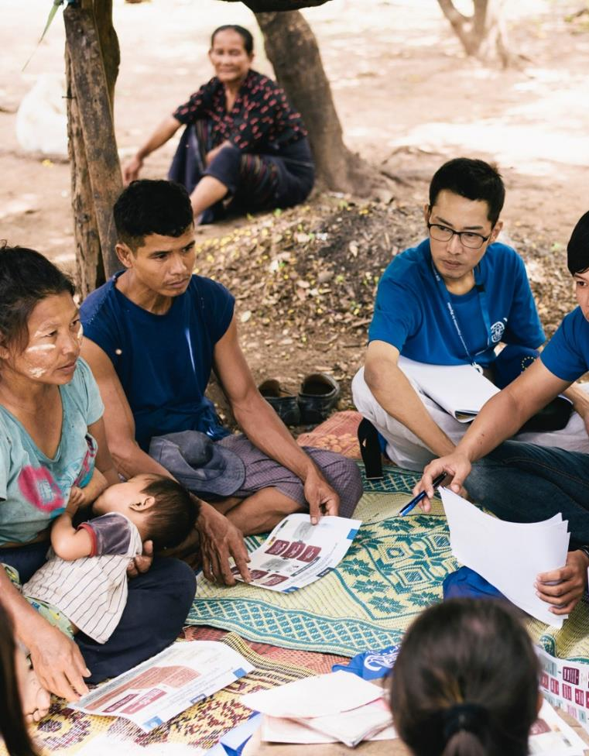
3. Research methods
Homogeneous group and with specific characteristics
The goal is to reach consensus or reach an agreement on the specific issue
Avoid previously established power dynamics
Number ranges from 6 to 10 (no set rule)
Language barrier is a major issue
Very limited number of key topics, not necessarily questions.
It is not a survey and the facilitator can use various techniques (brainstorming, illustrations, or timelines) to encourage discussion
The discussion process is as important as the answers
Cannot be quantified

Slide 37
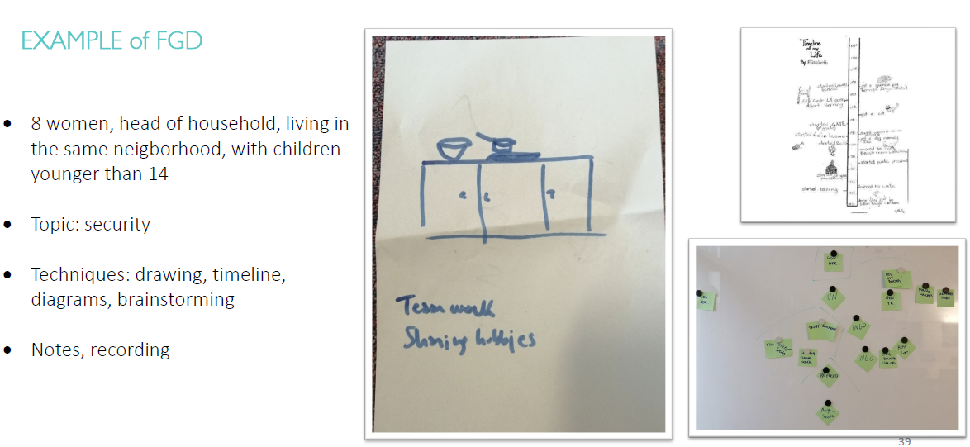
3. Research methods

Slide 38
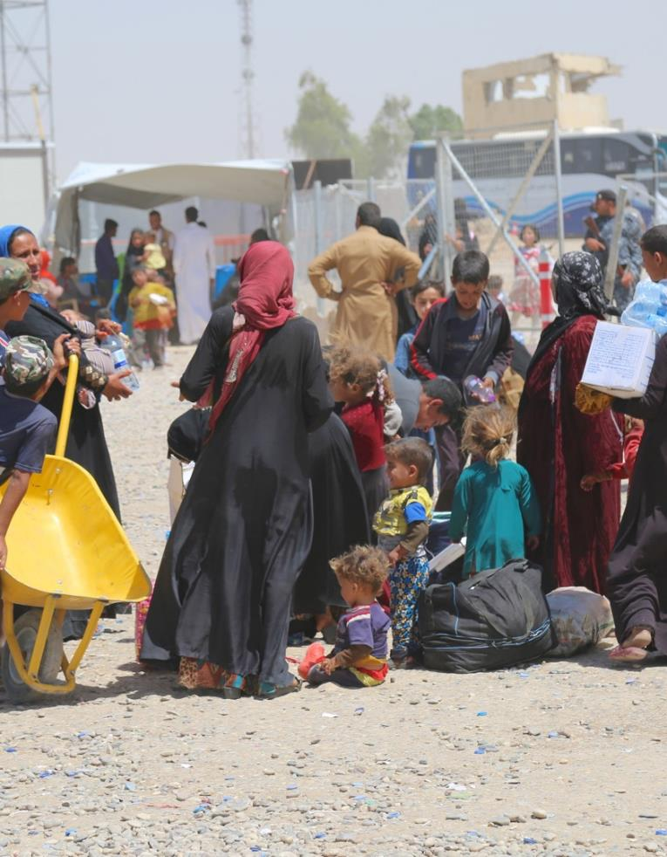
3. Research methods
WHEN INTERVIEWS/FGDs ARE ENOUGH?
When you reach saturation:
  You start hearing the same answers over and over
  You have reached all the respondents you had planned to reach

Slide 39
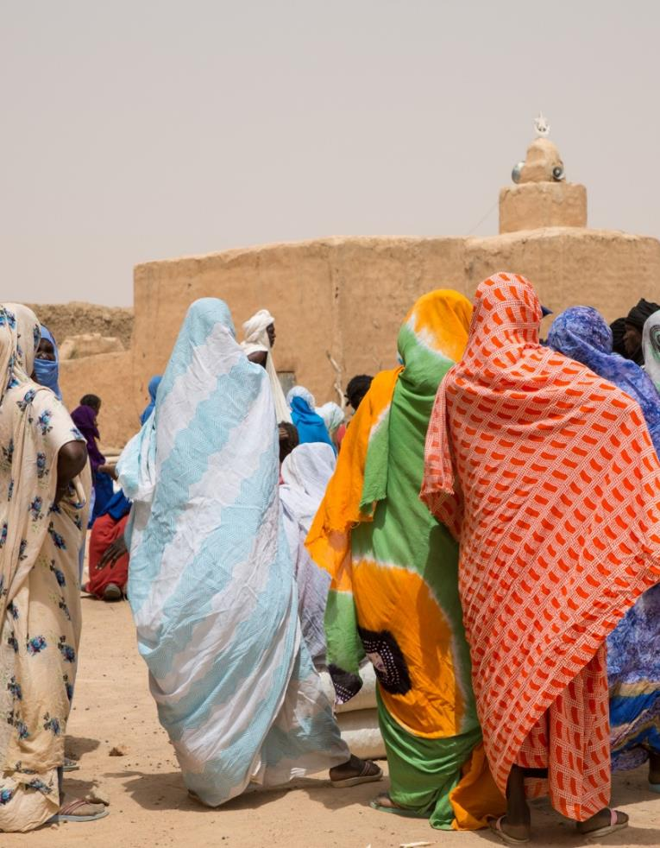
3. Research methods
ISSUES WITH QUALITATIVE DATA
Qualitative data are very complex to analyze and take a lot of time.
Interpretation plays a massive role. If staff is not trained, the interpretation can be arbitrary and more difficult to double check.
The analysis is not simply a summary of the notes.
It is an enormous effort of time
There are different techniques, for example:
  Thematic analysis
  Narrative analysis
  Discourse analysis

Slide 40
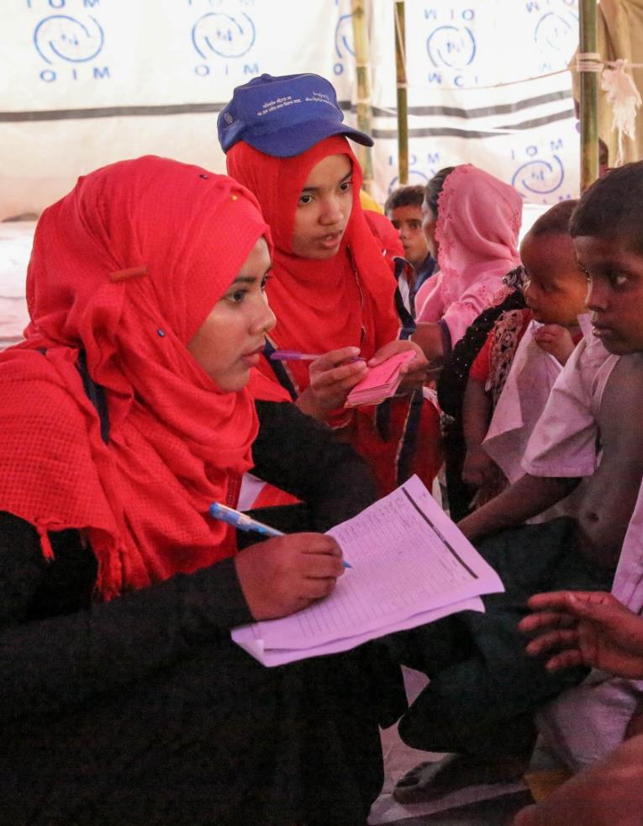
3. Research methods
QUALITATIVE RESEARCH METHODS CAN PROVIDE AN INCREDIBLE AMOUNT OF INFORMATION BUT ALSO BE A TRAP
They look simpler and less technical than quantitative ones, so entry barrier is lower.
They should be handled by staff who have received adequate qualitative research training.
They often present higher risks than quantitative (observation or surveys)
If staff is not trained, the risk of bias and misinterpretation is higher than quantitative.

Slide 41
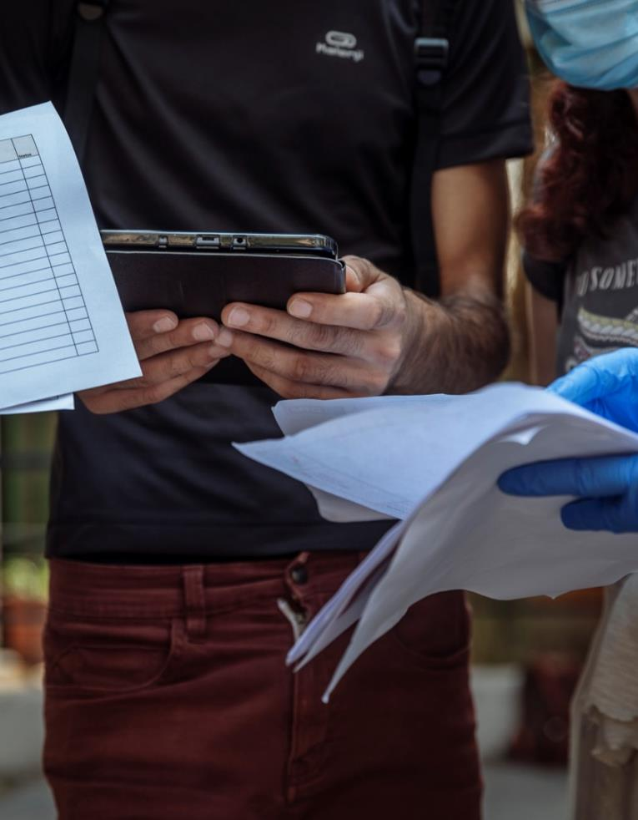
3. Research methods
STRUCTURED INTERVIEWS: SURVEYS
They consist of a questionnaire with closed questions in which a limited number of options are offered to the person surveyed.
They can be self-administered or administered by an interviewer (in person, by phone, online).
Sample: Typically the questionnaire is administered to a sample. If you had access to the entire population (census) you would not need a sample.

Slide 42




3. Research methods
MOBILITY TRACKING
FLOW MONITORING
Tracks mobility and cross-sectoral needs in locations of interest (systematically)
Tracks movement of flows at specific points
Groups
and Location
Sub-components:
Baseline Area/Location
Site/community Assessment (Stock population)
Emergency Event Tracking (Sudden large movement of population)
Sub-components:
Baseline Assessment
Flow Monitoring Registry
REGISTRATION
SURVEYs
Registers individuals or households for beneficiary selection, vulnerability targeting and programming
Gather specific information using sample from population of interest
Households and
Individuals
Sub-components:
Rapid Emergency Registrations
Verification for Registration
Biometric Registration
Examples:
Return Intention
Community Perception
Displacement Solutions
Flow Monitoring Surve

Slide 43
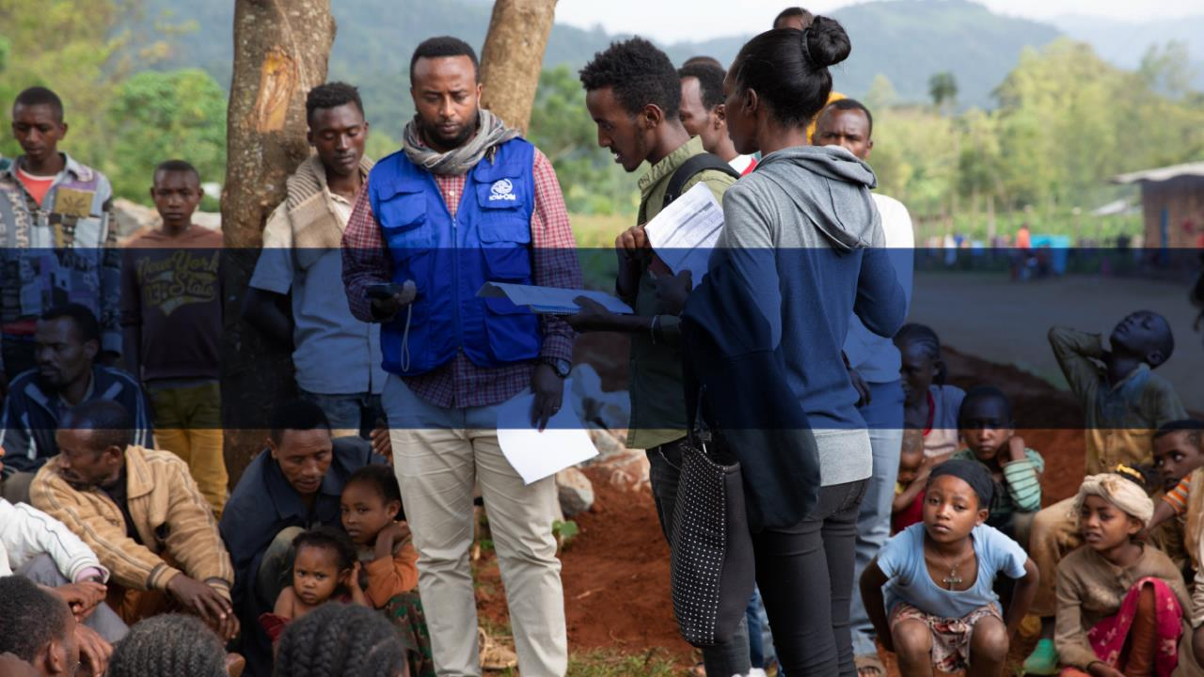
4. Exercise

Slide 44
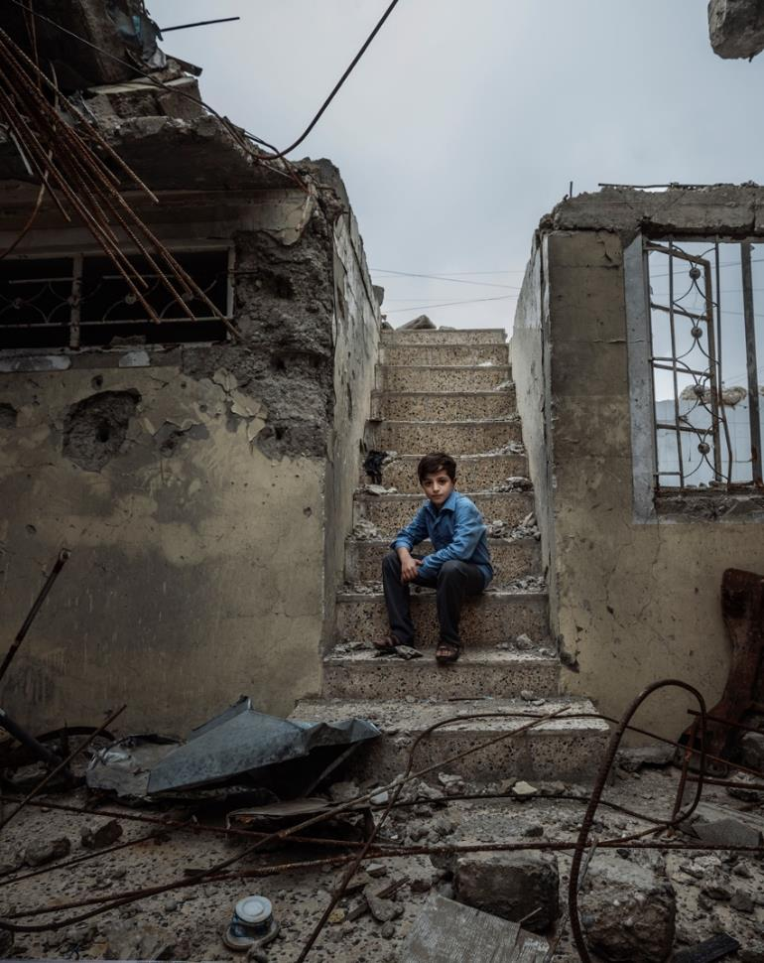
4. Exercice
Example 3
A 12-year-old boy lives with a family with a stable income and a good social position.
Another 12-year-old boy lives in the same neighbourhood, but he is an IDP and belongs to an ethic minority. He holds no ID as authorities do not issue them easily to members of his ethnic group and IDP registration is not completed yet. He comes from a loving family, but his parents struggle in finding regular employment because of their legal status. They are thinking of pulling him out of school to contribute to the family income.
Flyers advertising scholarships and job opportunities abroad start appearing in the areas around schools in their neighbourhood.

Slide 45
4. Exercice
Structural factors (A)
A.6 | Existing national or transnational migration routes, internal and cross-border voluntary and forced population movement trends and patterns
A.7 | Existing or known trafficking trends and patterns at the time of research or pre-existing trafficking trends and patterns before an emergency started at the national level
A.15 | Discriminatory practices or laws against ethnic or religious minorities or social groups
Community factors (B)
B.3 | Local power structure, community structure and presence of marginalized groups
B.4 | Community migration or displacement history, linkages to the diaspora or members of the community elsewhere (in the same country or abroad), and displacement patterns and their impact on social cohesion of the community
B.5 | Freedom of movement and mobility patterns
B.6 | Presence of IDPs/refugees/returnees and relationship with host community (intra-community and intercommunity dynamics, social cohesion)
B.7 | Sense of impunity/Weak or absent rule of law or law enforcement at the community level
B.8 | Local power structure, community structure and presence of marginalized groups
Family factorc (C)
C.1 | Household and family composition (roles and needs by age and gender, members with disabilities)
C.3 | Income sources (socioeconomic or livelihood conditions)/Reliance on children contributing to the household income
C.6 | Family migration and/or displacement history (internal or international), including the origin, date of arrival, and linkages to the diaspora or networks in the country or outside
C.7 | Legal status (e.g. IDP, asylum seeker, refugee, stateless person)/ID and legal documents/Work or residency permit
C.8 | Personal and social characteristics leading to marginalization or discrimination (e.g. ethnicity, religion, social class, family structure)
C.10 | Fear or mistrust of authorities or law enforcement
C.13 | amily members or breadwinner active in sectors typically related to exploitation

Slide 46
4. Exercice
Structural factors (A)
A.6 | Existing national or transnational migration routes, internal and cross-border voluntary and forced population movement trends and patterns.
A.7 | Existing or known trafficking trends and patterns at the time of research or pre-existing trafficking trends and patterns before an emergency started at the national level.
A.15 | Discriminatory practices or laws against ethnic or religious minorities or social groups.
What source would you use?
Primary or secondary data?
What research methods?

Slide 47
4. Exercice
Community factors (B)
B.3 | Existing or known trafficking trends and patterns at the time of research or pre-existing trafficking trends and patterns before an emergency started at the community level.
B.4 | Local power structure, community structure and presence of marginalized groups.
B.6 | Freedom of movement and mobility patterns.
B.7 | Presence of IDPs/refugees/returnees and relationship with host community (intra-community and intercommunity dynamics, social cohesion).
B.8 | Sense of impunity/Weak or absent rule of law or law enforcement at the community level.
What source would you use?
Primary or secondary data?
What research methods?

Slide 48
4. Exercice
Household and family factors (C)
C.1 | Household and family composition (roles and needs by age and gender, members with disabilities).
C.3 | Income sources (socioeconomic or livelihood conditions)/Reliance on children contributing to the household income.
C.7 | Legal status (e.g. IDP, asylum seeker, refugee, stateless person)/ID and legal documents/Work or residency permit.
C.8 | Personal and social characteristics leading to marginalization or discrimination (e.g. ethnicity, religion, social class, family structure).
C.10 | Fear or mistrust of authorities or law enforcement.
What source would you use?
Primary or secondary data?
What research methods?

Slide 49
4. Exercice
N.º | MEANS | (Potential) indicators of the MEANS
D.M.8 | Threat or use of force/Deception | Threat of denunciation to authorities or deportation (illegal migration status/involvement in illicit activities).
D.M.9 | Coercion | No freedom of movement, can’t leave work premises or accommodation without permission or only if escorted by employer.
D.M.18 | Deception/Abuse of power and vulnerability | Distrust of authorities, police, law enforcement or humanitarian workers.
D.M.22 | Deception/Fraud | Deception about travel and recruitment conditions.
What source would you use?
Primary or secondary data?
What research methods?
!
!
THE COLLECTION OF DATA RELATED TO THE INDIVIDUAL LEVEL DOES NOT NEED AN INTERACTION WITH THE INDIVIDUAL.

Slide 50
4. Exercice
N.º | PURPOSE | (Potential) indicators of the PURPOSE
D.P.2 | Prostitution or sexual exploitation | Conditions of sex slavery.
D.P.3 | Forced marriage | Early marriage.
D.P.4 | Forced marriage | Forced marriage.
D.P.8 | Forced labour or labour exploitation | Working against one’s will.
D.P.19 | Child labour exploitation | No access to education.
D.P.21 | Domestic servitude | Domestic servitude.
DO NO HARM
PRIMARY DATA: For example, during a focus group discussion we can address the general issue of marriage practices in a community.
Or for example by talking to key informants we could discover that there are many cases of early marriage.
SECONDARY DATA: Through MIMOSA, months after handling some cases, we could get some information about the victims that OIM assisted.

Slide 51
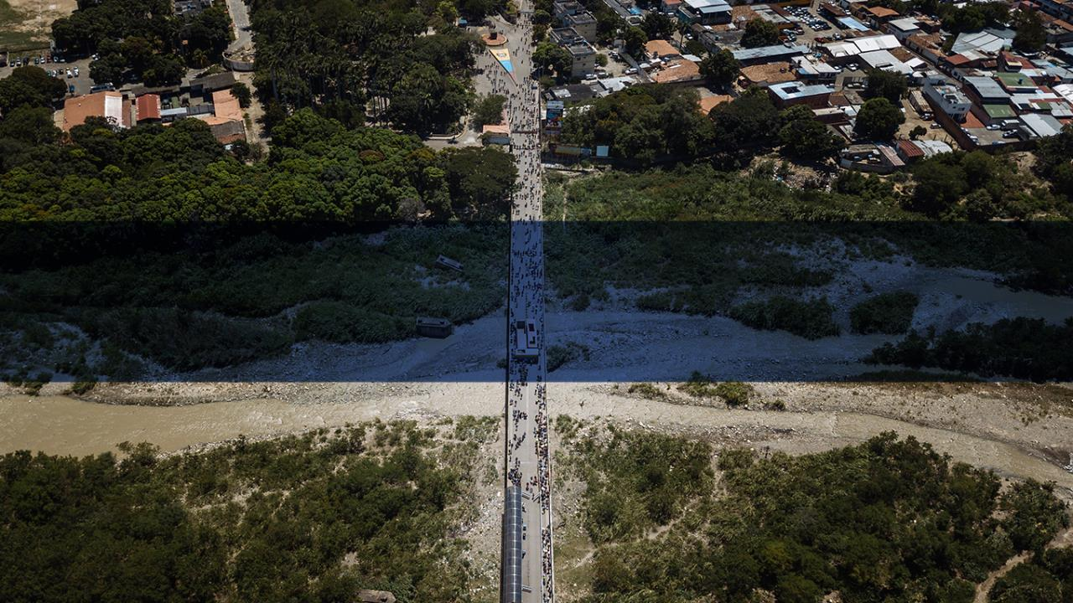
Questions

Slide 52
Further readings and recommended sources
Counter-trafficking in Emergencies: Information Management Guide
Chapter 7 – Research Methods
TRAININGS
IOM eCampus: Counter Trafficking in Humanitarian Settings.
UNODC eLearning: Human Trafficking.

Slide 53
Further readings and recommended sources
Bryman, 2012: Social research methods.
GPC InterAction’s Protection Working Group, 2003: Data collection in humanitarian response: A guide for incorporating protection.
JIPS, 2020: Sampling guide for displacement situations and practical examples.
Nexus Institute, 2019: Good Practice in TIP Data Collection: Recommendations for Donors and Funders.
Nexus Institute, 2019: The Science (and Art) of Understanding Trafficking in Persons: Good Practice in TIP Data Collection.
Nexus Institute and IOM, 2014: Traffickers and trafficking: Challenges in researching human traffickers and trafficking operations.

Slide 54
For Support, contact:
IOM Migrant Protection and Assistance Division (MPA):
Counter Trafficking in Emergency Team: CTiEHQ@iom.int

